Slide 1
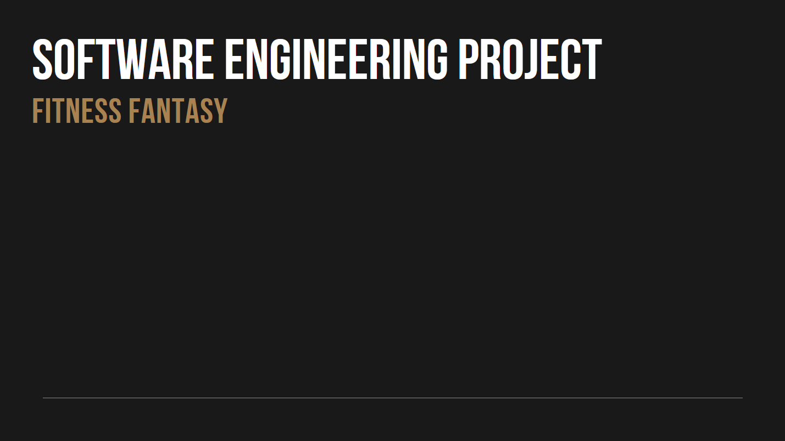
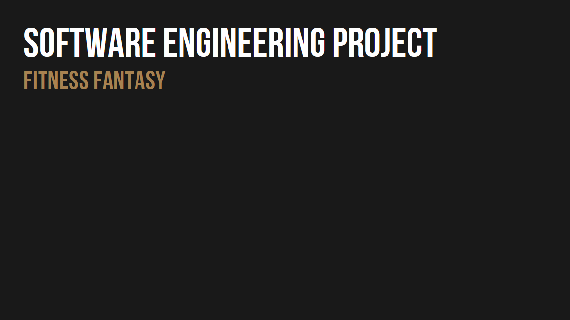


+
Made by :
Ugo DEMY
Charles DELEMAZURE
Tristan SOLUS

Slide 2



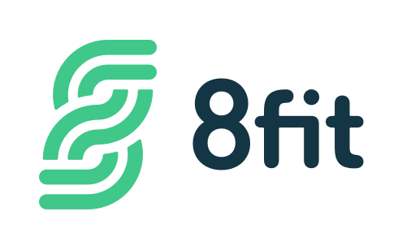
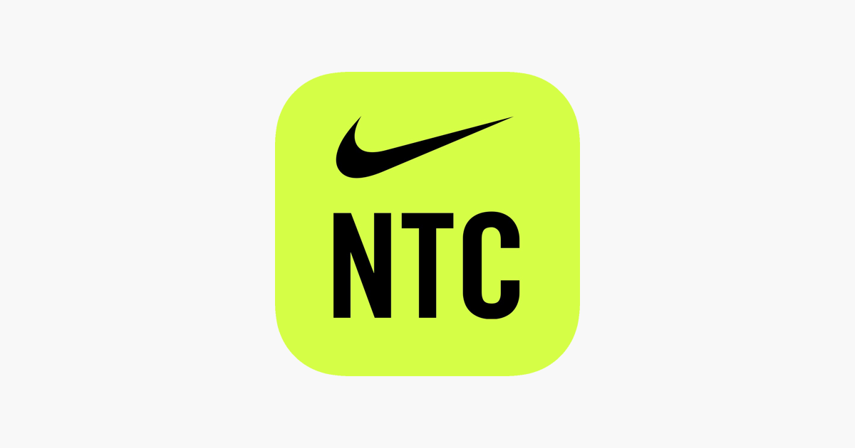
I. Softwares in use
The Johnson & Johnson official 7-minute workout
8 - Fit
Nike Training Club

Slide 3






II. Choice of Software Development Platforms
Mysql WorkBench 8.0
AWS - RDB
Sublime Text 3
XAMPP
Visual Studio 2017
React

Slide 4

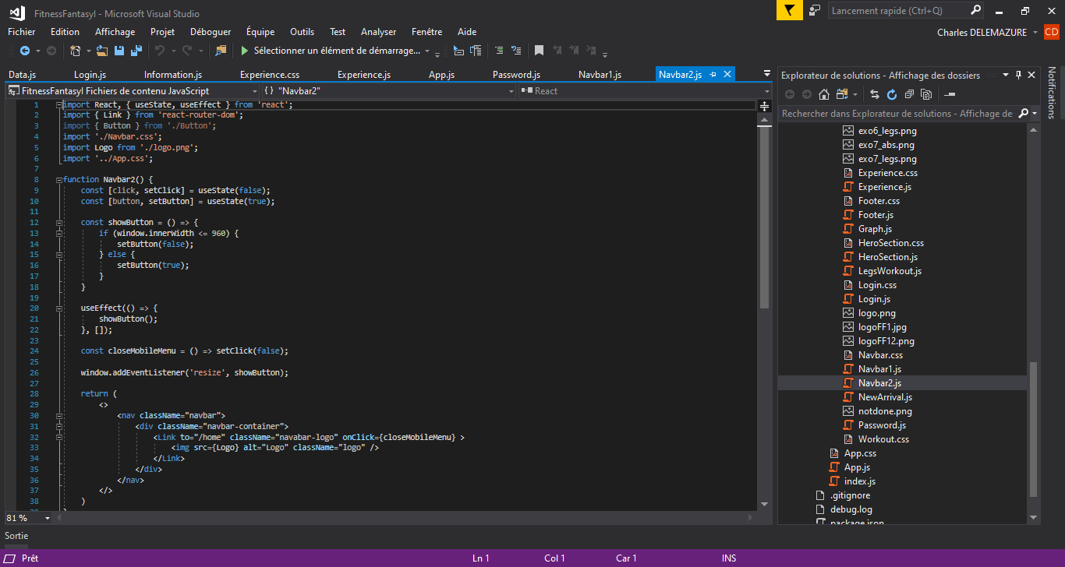
III. Frontend – React.js
React is a trendy, intuitive and convinient language
Make our webapp the most user-friendly possible ➔ Naviguation bar
Problems and obstacles: difficulties to connect the frontend with the backend due to a lack of skills and knowledge in these software development platforms.

Slide 5


IV. Backend Architecture

Slide 6


V. User Cases
➔ Home Page

Slide 7
V. User Cases
➔ Navigation Bar

Slide 8
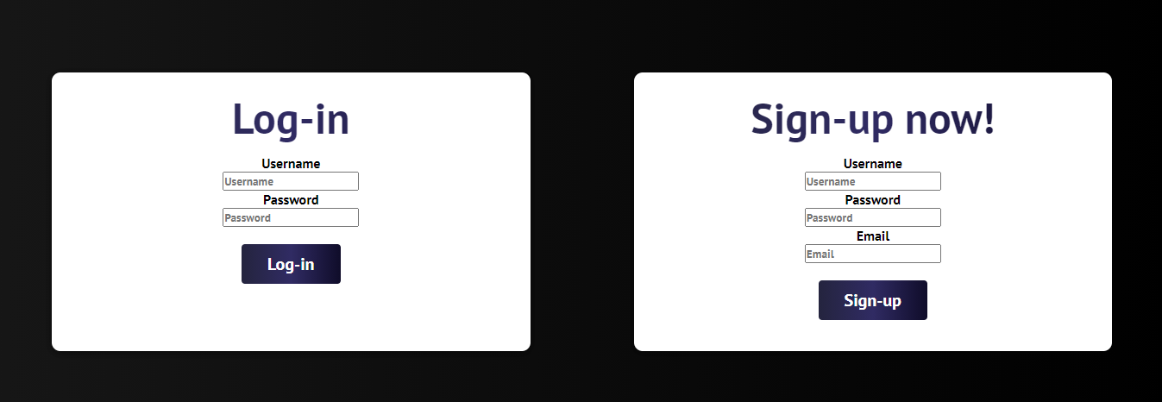
V. User Cases
➔ Log In / Sign Up

Slide 9
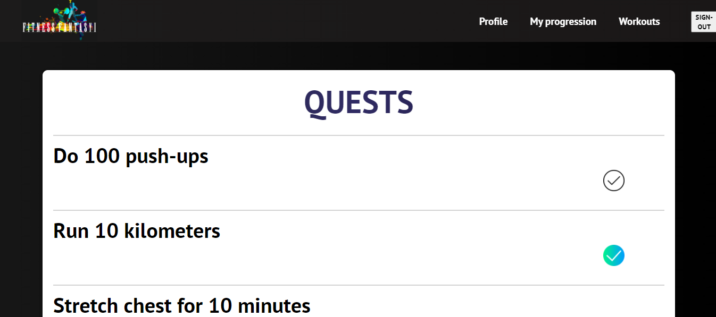
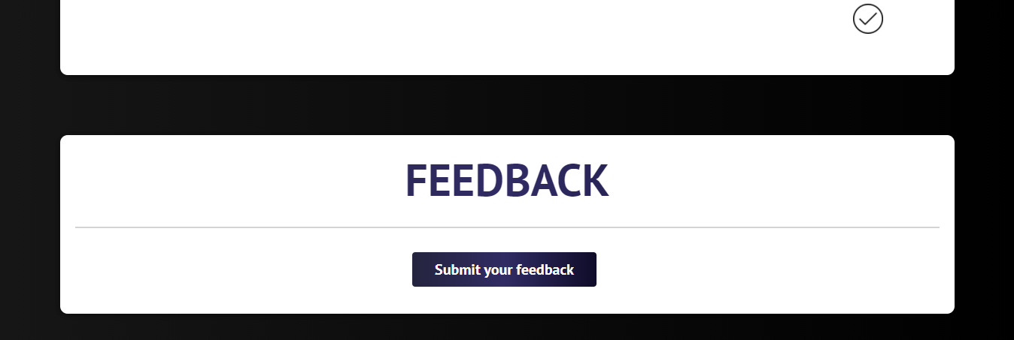
V. User Cases
➔ Quests Page

Slide 10
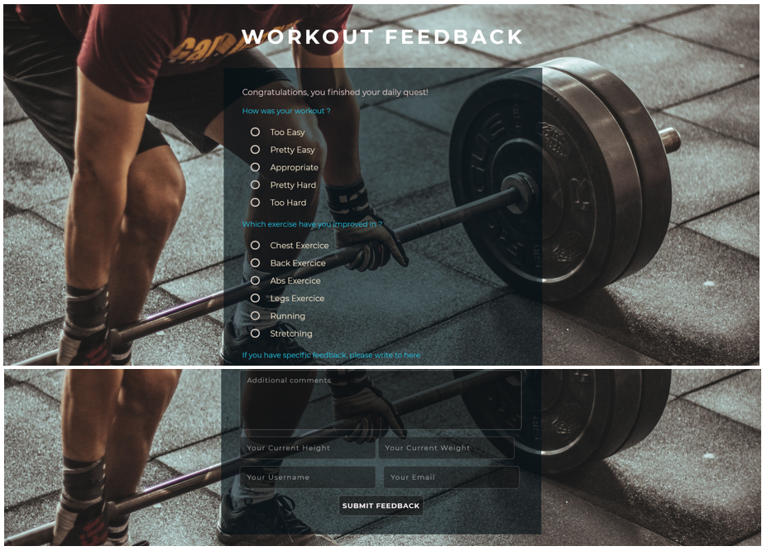
V. User Cases
➔ Feedback Page

Slide 11
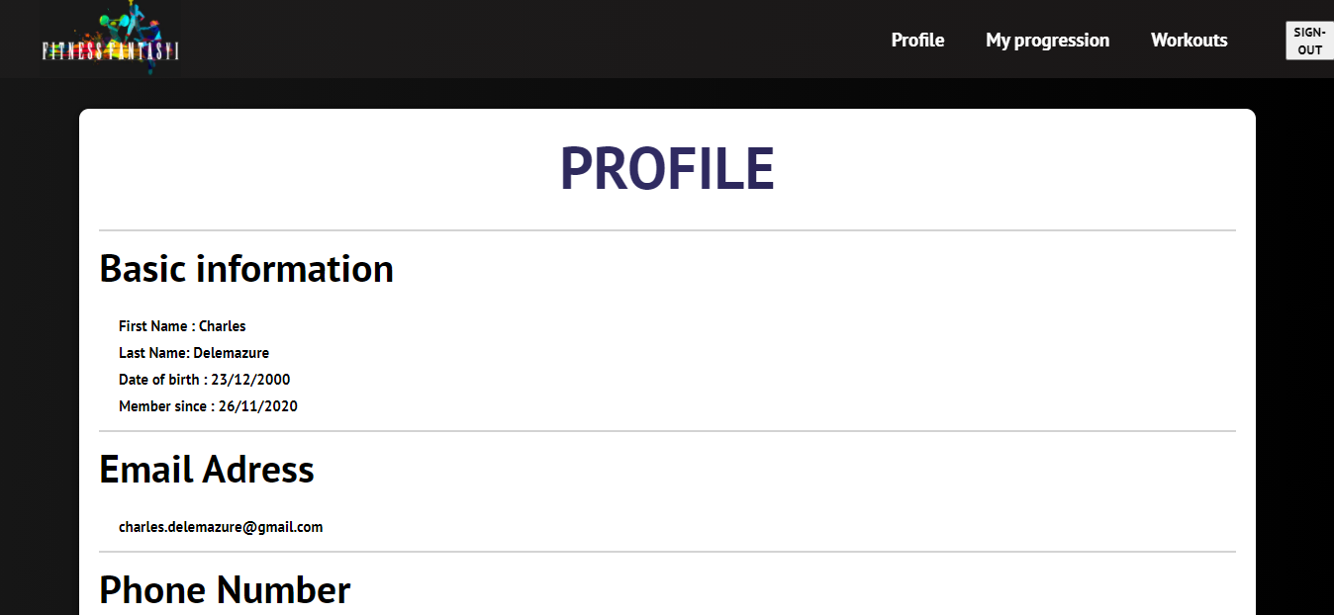
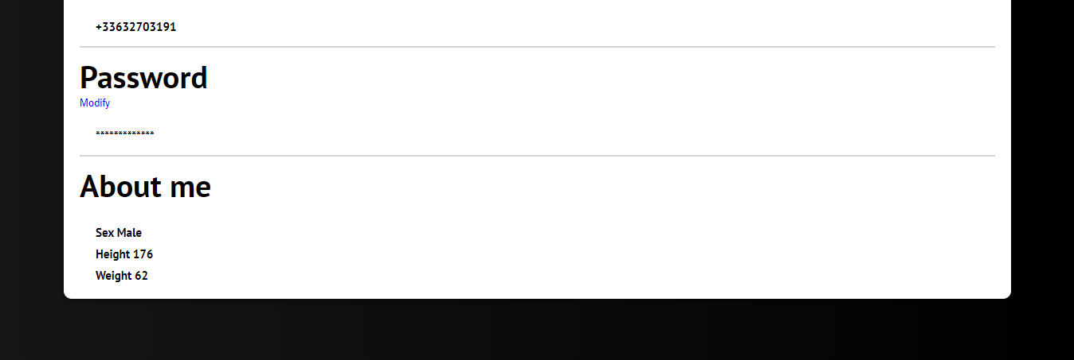
V. User Cases
➔ Profile Page

Slide 12
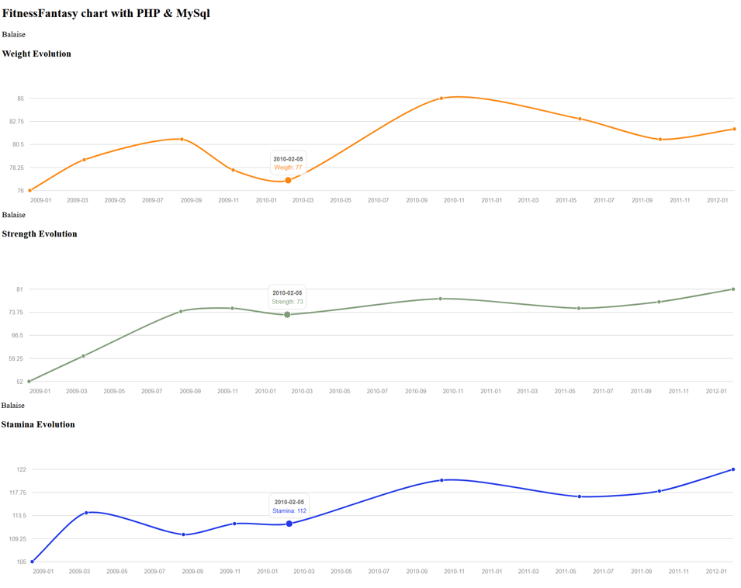
V. User Cases
➔ Progression Page

Slide 13
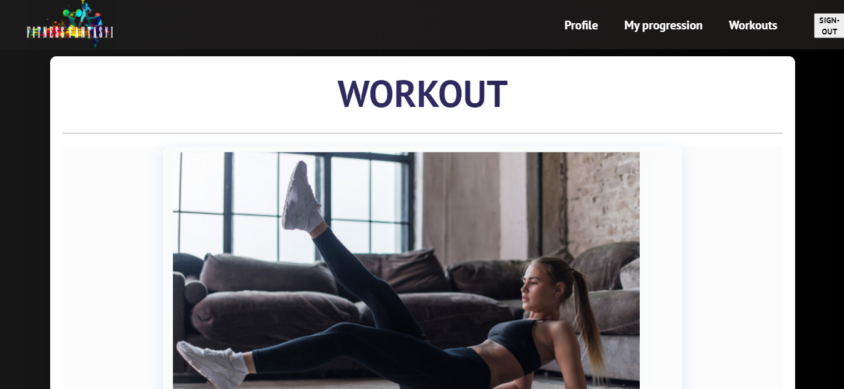
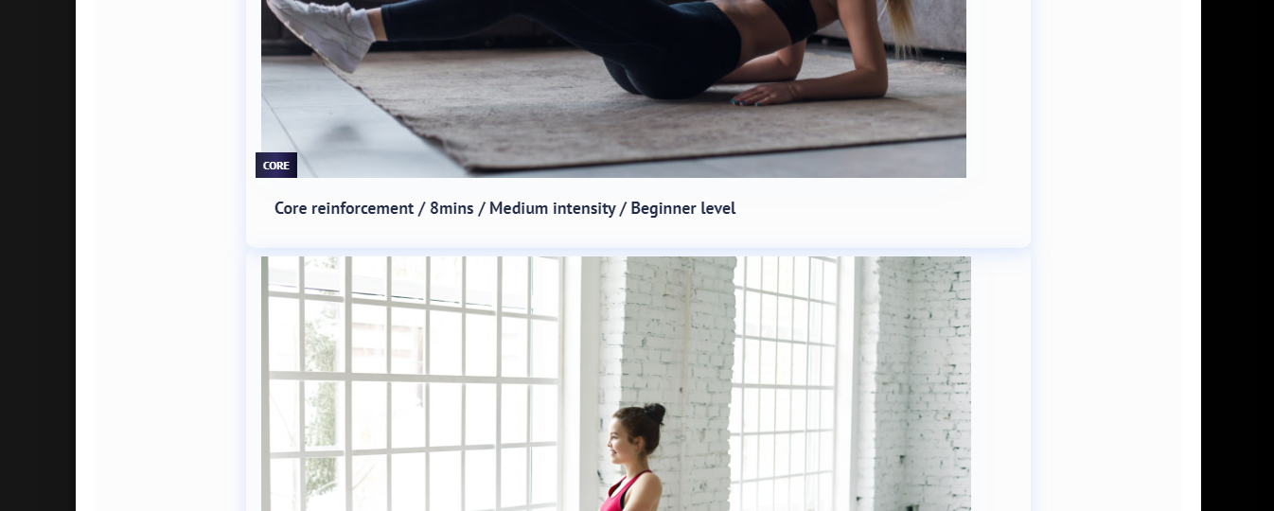
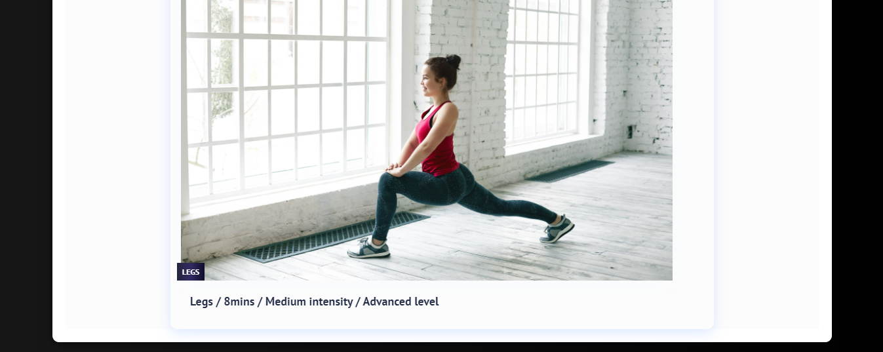
V. User Cases
➔ Workout Page

Slide 14
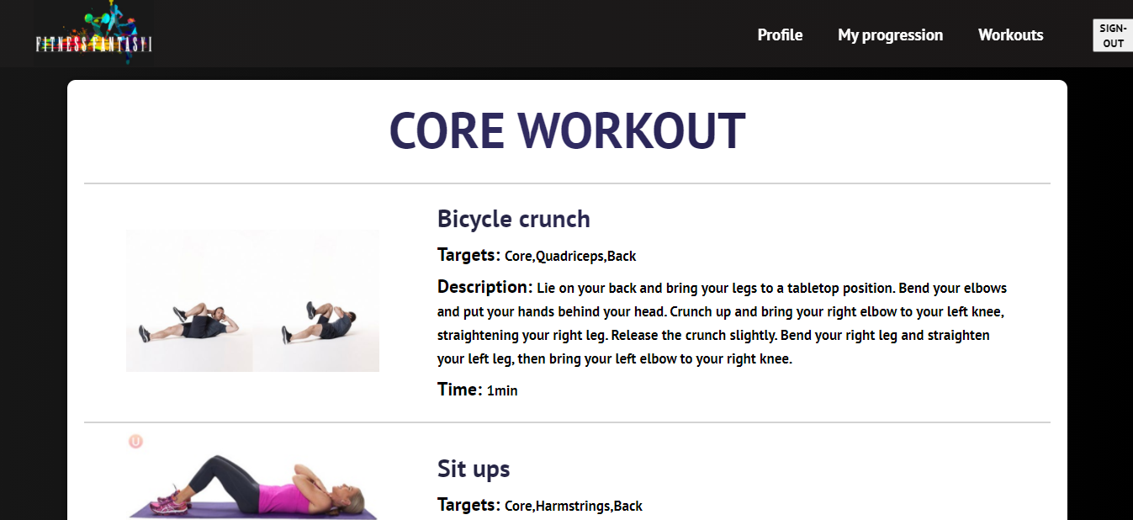
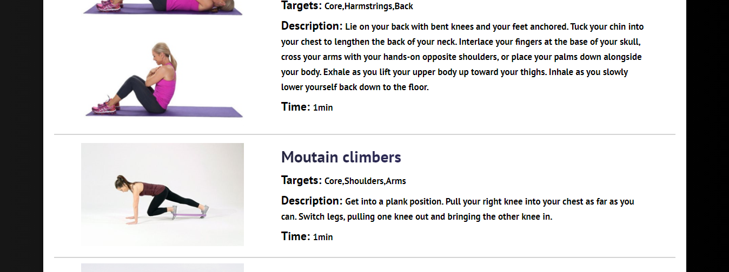
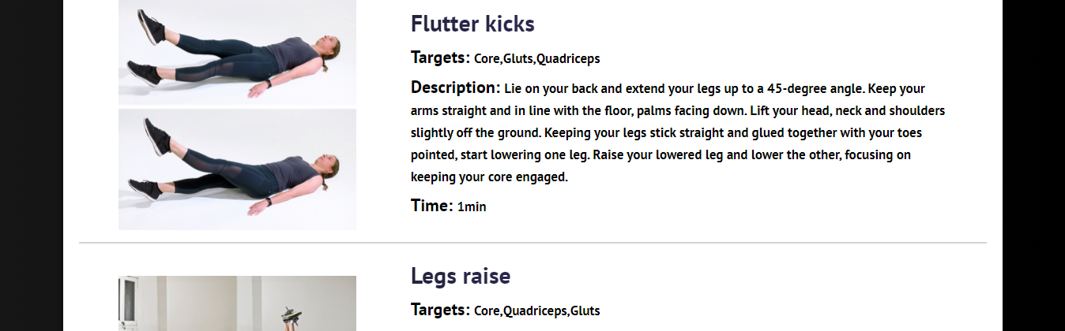
V. User Cases
➔ Core Workout Page

Slide 15
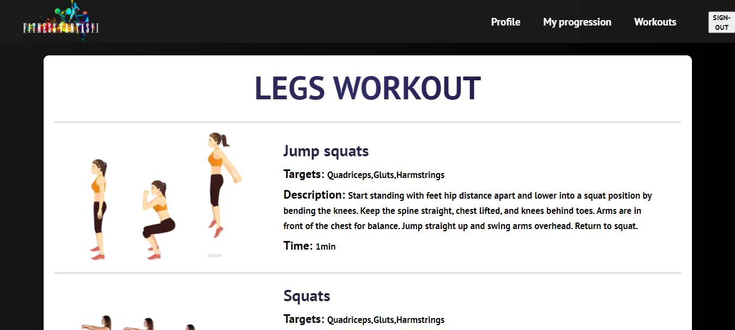
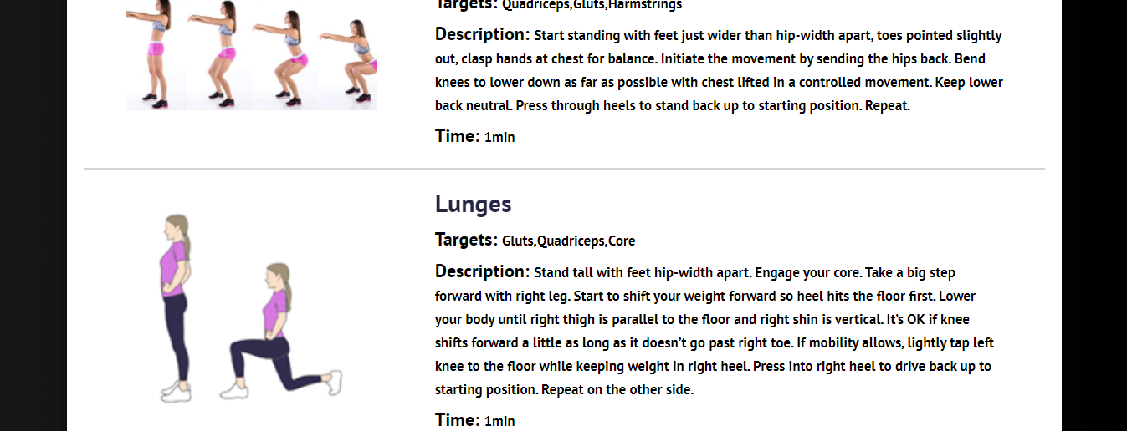
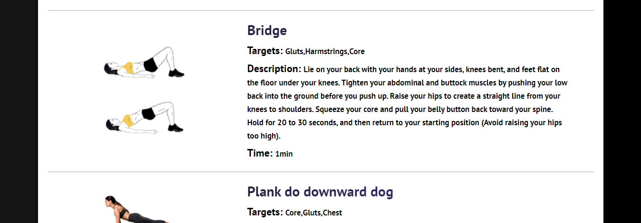
V. User Cases
➔ Legs Workout Page

Slide 16


VI. Conclusion

